Slide 1

Loan Status Prediction Models
Using Machine Learning in order to predict the result of a loan application Ionita Alexandru-Mihail, 1241B
12th of December, 2024

Slide 2
Introduction
Our scope for this project is to create a prediction model that can accurately predict whether or not a person will get their loan approved based on multiple factors.
For our dataset, we used the Loan Approval Classification Dataset, a synthetic dataset inspired by the Credit Risk Dataset and enriched with additional variables

Slide 3
Exploratory Data Analysis
Variable Name | Variable Description | Variable Type
person_age | Age of the person | Flot
person_gender | Gender of the person | Categorical
person_education | Highest education level | Categorical
person_income | Annual income | Float
person_emp_exp | Years of employment experience | Integer
person_home_ownership | Home ownership status | Categorical
loan_amnt | Loan amount requested | Float
loan_intent | Purpose of the loan | Categorical
loan_int_rate | Loan interest rate | Float
loan_percent_income | Loan amount as percentage of annual income | Float
cb_person_cred_hist_length | Length of credit history in years | Float
credit_score | Credit Score of the person | Integer
previous_loan_defaults_on_file | Indicator of previous loan defaults | Categorical
loan_status | Loan approval staus: 1 = approved; 0 = rejected | Integer
In our dataset we have 45.000 entries, each with 14 variables
There are no gaps in our dataset, meaning that all variable values are known for all entries

Slide 4
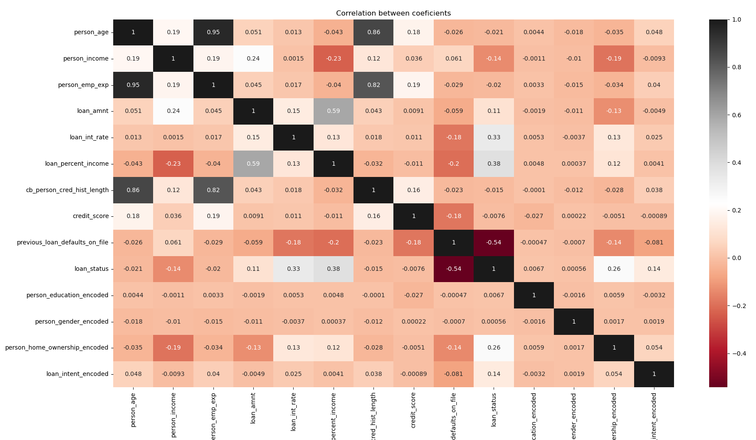
Correlation Matrix
From the correlation matrix, we can observe the following correlations:
Higher experience and credit length directly proportional with the age of a person
Loan amount directly proportional with the income of a person
Previous loan inversely proportional with the status of the loan

Slide 5
Other observations about our dataset
Our dataset contains mostly applicants with ages between 20 and 30 years, which can bias our model
The variable with the most outliers is loan_status, with ~10.000 outliers. By looking at the dataset we can see that the outliers are the cases in which the loan is approved, as most loan applications are denied

Slide 6
Data Preprocessing
For encoding non-numerical data I’ve used the Label Encoding method, for simplicity
SMOTE was used for oversampling in order to deal with the imbalance between the cases in which loans are approved vs. loans that are denied. This way, our model doesn’t get a bias for the cases in which the loan is denied.
Implementing PCA gave worse accuracies in every scenario, but it is not as necessary due to our fast training times
No need to do interpolation on our dataset, as there are no missing values in our entries

Slide 7
Machine Learning Models
In no particular order, The models I tried implementing are:
Random Forest
K-Nearest Neighbors (KNN)
Decision Tree
XGBoost
Logistic Regression
They have been chosen due to having past experience with them.

Slide 8
Training Results
Most of our models have an accuracy between 77-79%
Our best performing models are XGBoost and Random Forest, with both at around 79.4% accuracy
K-Fold Cross-Validation Scores: [0.77166667 0.77466667 0.77455556 0.77333333 0.77411111]
Mean Accuracy: 0.7736666666666666
Standard Deviation of Accuracy: 0.0011044243235368244

Slide 9
Conclusions & future improvements
The dataset is generally good, but the acceptance / rejection imbalance is a bit too big. The dataset also mostly focuses on younger people, as there is not enough data on older people trying to get a loan
Better preprocessing of our data & better outlier handling would improve the performance of our model as well
If we were to create a model that would be used in a real scenario, I would choose between Random Forest & XGBoost, as they were the best performing models and make adjustments from there on, depending on our choice.

